Slide 1

Billboard Design
Designing pages for scanning, not reading

Slide 2
5 Important Things
Create a clear visual hierarchy on each page
Take advantage of conventions
Break pages up into clearly defined areas
Make it obvious what’s clickable
Minimize noise

Slide 3
#1 Create a clear visual hierarchy
The more important something is the more prominent it is
Very Important
A little less important
Nowhere near as important

Slide 4
Create a clear visual hierarchy
Things that are related logically are also related visually
  Group them together under common heading
  Display them in a similar visual style
  Put them all in a clearly defined area

Slide 5
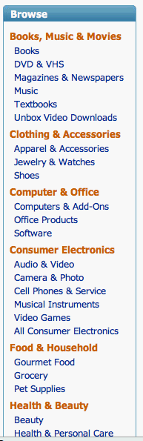
Logical relationship should = visual relationship

Slide 6
Create a clear visual hierarchy
Things are “nested” visually to show what is part of what

Slide 7
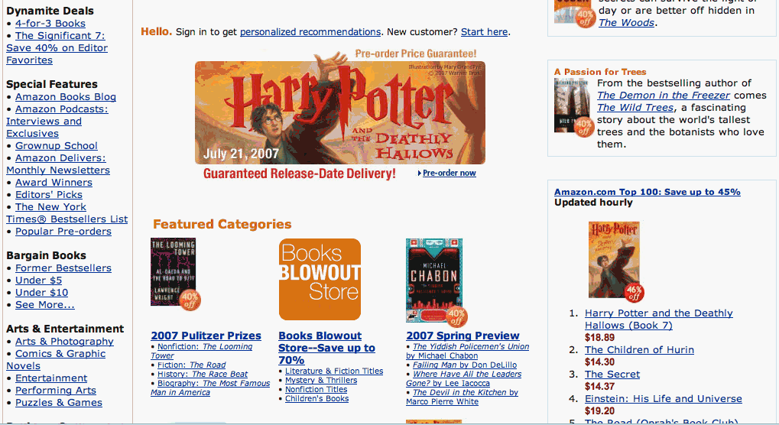
Amazon.com

Slide 8
A good visual hierarchy:
Saves us work by preprocessing the page for us
Organizes content
Prioritizes content
Almost instant understanding of a page with good visual hierarchy

Slide 9
#2 Take advantage of conventions
Newspaper conventions that we learned at a young age
  Headlines summarize stories
  Caption under a picture tells about pic
Conventions allow us to quickly scan and look for stories of interest

Slide 10
Web Conventions
Useful
Provide reassuring sense of familiarity
  Navigation down the left side of the page
Designers often reluctant to take advantage of conventions

Slide 11
Web Conventions
If not using conventions, then make sure your alternative has zero learning curve, or that the new design idea is so important that it is worth the learning it will require.

Slide 12
#3 Break up pages into clearly defined areas
User should be able to look at an area and state its purpose:
  Links to top stories
  Products this company sells
  Things they really want to sell me
  Navigation to rest of the site
Allows user to decide quickly where to focus

Slide 13
#4 Make it obvious what’s clickable
Understanding what is clickable should be mindless
Decide on a system for what a link looks like and stick to it.
Avoid “click here” and “link” as names for hyperlinks

Slide 14
#5 Minimize the noise
Visual noise is one of the big problems that easy-to-grasp web pages face
Busy-ness: everything on the page clamors for my attention. Lots of exclamation points. Lots of visual shouting going on.
Background noise: things you might think are background become annoying

